Slide 1
VIDEO

Slide 2
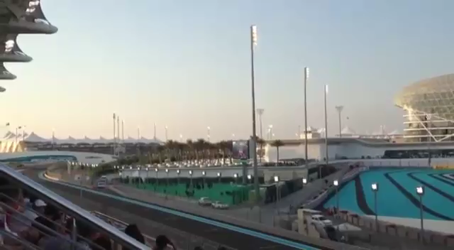
VIDEO-Marina grandatand

Slide 3
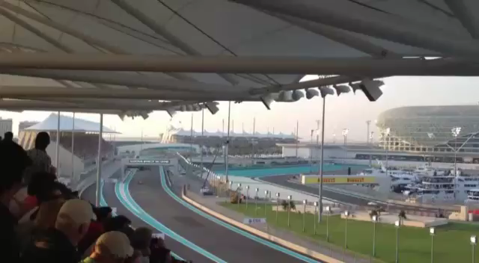
VIDEO-South grandatand

Slide 4
VIDEO-North grandatand

Slide 5
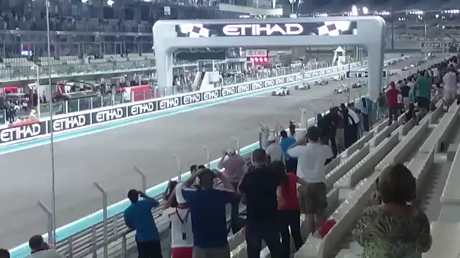
VIDEO-Main grandatand

Slide 6
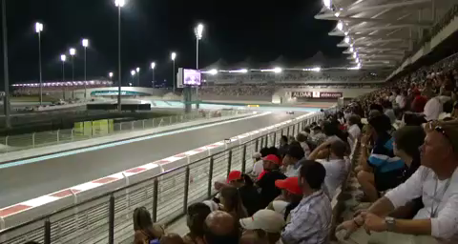
VIDEO-West grandatand

